Slide 1
Docker Storage

Slide 2
Why Volumes ?
By default all files created inside a container are stored on a writable container layer.
The data doesn’t persist when that container is no longer running, and it can be difficult to get the data out of the container if another process needs it.
A container’s writable layer is tightly coupled to the host machine where the container is running. You can’t easily move the data somewhere else.
Writing into a container’s writable layer requires a storage driver to manage the filesystem.

Slide 3
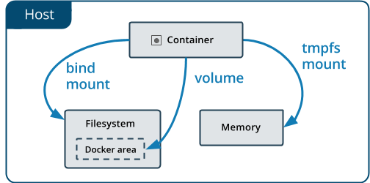
Choose the right type of mount

Slide 4
Volumes?
Volumes are stored in a part of the host filesystem which is managed by Docker(/var/lib/docker/volumes/ on Linux).
Non-Docker processes should not modify this part of the filesystem.
Volumes are the best way to persist data in Docker.

Slide 5
Choose the right type of mount : bind
Bind mounts may be stored anywhere on the host system.
They may even be important system files or directories.
Non-Docker processes on the Docker host or a Docker container can modify them at any time.

Slide 6
Choose the right type of mount :tmpfs
tmpfs mounts are stored in the host system’s memory only,
Never written to the host system’s filesystem.

Slide 7
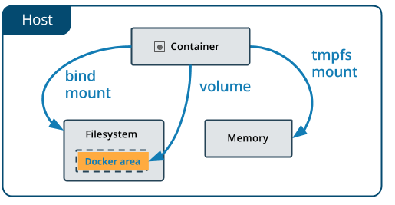
Volumes

Slide 8
Volumes
Volumes are the preferred mechanism for persisting data generated by and used by Docker containers.
Volumes are easier to back up or migrate than bind mounts.
You can manage volumes using Docker CLI commands or the Docker API.
Volumes work on both Linux and Windows containers.

Slide 9
Volumes
Volumes can be more safely shared among multiple containers.
Volume drivers let you store volumes on remote hosts or cloud providers, to encrypt the contents of volumes, or to add other functionality.
New volumes can have their content pre-populated by a container.

Slide 10
Use Cases for Volumes
Sharing data among multiple running containers.
When the Docker host is not guaranteed to have a given directory or file structure.
Helps decouple the configuration of the Docker host from the container runtime.
Storing your container’s data on a remote host or a cloud provider.
Back up, restore, or migrate data from one Docker host to another

Slide 11
Volume Commands
Create a volume
$ docker volume create my-vol
List volumes
$ docker volume ls
Inspect a volume
$ docker volume inspect my-vol
Remove a volume
$ docker volume rm my-vol

Slide 12
Volume Commands
$ docker run -d \
--name devtest \
--mount source=myvol2,target=/app \
nginx:latest
$ docker run -d \
--name devtest \
-v myvol2:/app \
nginx:latest

Slide 13
-v or --mount flag
Originally, the -v or --volume flag was used for standalone containers and the --mount flag was used for swarm services.
--mount is more explicit and verbose.
-v syntax combines all the options together in one field, while the --mount syntax separates them.
New users should try --mount syntax which is simpler than --volume syntax.

Slide 14
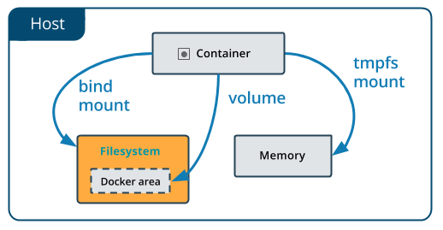
Bind Mounts

Slide 15
Bind Mounts
When you use a bind mount, a file or directory on the host machine is mounted into a container.
The file or directory is referenced by its full or relative path on the host machine.
The file or directory does not need to exist on the Docker host already. It is created on demand if it does not yet exist.
Bind mounts are very performant, but they rely on the host machine’s filesystem having a specific directory structure available.

Slide 16
Use Cases for Bind Mounts
Sharing configuration files from the host machine to containers.
Sharing source code or build artifacts between a development environment on the Docker host and a container.
When the file or directory structure of the Docker host is guaranteed to be consistent with the bind mounts the containers require.

Slide 17
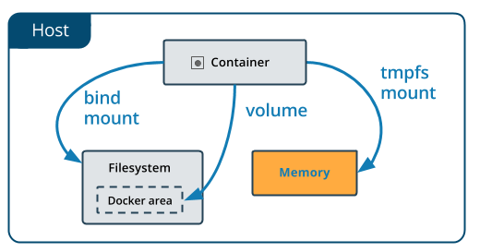
tmpfs mounts

Slide 18
tmpfs mounts
If you’re running Docker on Linux, you have a third option: tmpfs mounts.
When you create a container with a tmpfs mount, the container can create files outside the container’s writable layer.
tmpfs mount is temporary, and only persisted in the host memory.

Slide 19
tmpfs mounts
Limitations of tmpfs mounts
Unlike volumes and bind mounts, you can’t share tmpfs mounts between containers.
This functionality is only available if you’re running Docker on Linux.

Slide 20
Use Cases for tmpfs mounts
When you do not want the data to persist either on the host machine or within the container.
This may be for security reasons or to protect the performance of the container when your application needs to write a large volume of non-persistent state data.

Slide 21
Hands-on LAB

